Slide 1
Housing Federally Funded High Quality Preschools In K-12 Schools
Will it make a difference?
By Kristen Letcher, Sarah Staples, Karen Guettler,
Hannah Zing, and Nicole Stephens

Slide 2
Adequate Educational Opportunity is
A Constitutional Right!
Fourteenth Amendment
guarantees national citizenship

Slide 3
National citizenship means...
The national government is obligated to ensure that all citizens have the opportunity for full membership, effective participation, and equal dignity accorded a U.S. citizen.

Slide 4
Thus:
The duty of the U.S. legislature is “to ensure that all children have adequate educational opportunity for equal citizenship”
(Liu, 2006, p.335)
understanding and living those rights.

Slide 5
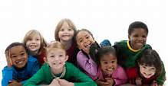
Title VI of the 1964 Civil Rights Act
Title VI bans discrimination in any federally funded program based on race, color, or natinal origin.
Everyone has a right to this educational opportunity!

Slide 6
Title VI of the 1964 Civil Rights Act
Plaintiffs were parents of students who spoke English as a second language.
Supreme court ruled that students who were not provided a meaningful opportunity to participate in educational programs are discriminated against. (Spring, 2014)

Slide 7
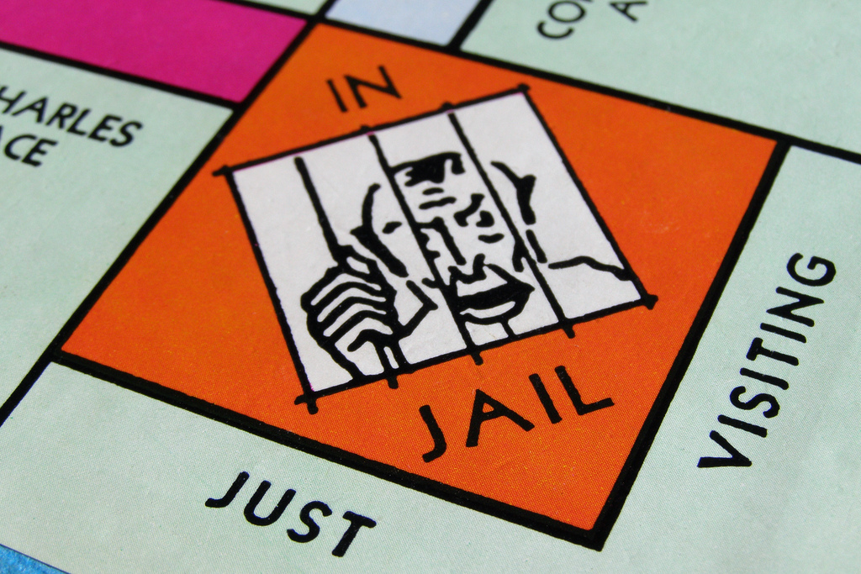
Good citizenship and preschool
Good citizenship
starts in preschool.
Research
indicates lower rates
of crime and incarceration for students who attend high-quality preschools.

Slide 8
Studies around the world...
Participation in high-quality preschool leads to:
reduction of socioeconomic disparities and perceptions of poverty
Edward Melhuish (2011) notes researchers believe that high-quality preschools are a means of advancing the social welfare of all.

Slide 9
Communication
Relationships:
Preschool students learn to communicate with adults; relationship and trust building occurs with their teachers.
Preschool students work in groups and learn to communicate and work with their peers.

Slide 10
Communication
Early start and Head start programs provide Speech and Language Pathology (SLP) services to students with need.

Slide 11
Communication is essential!
Without it, we cannot
convey what we know
request the things we need
protect ourselves

Slide 12
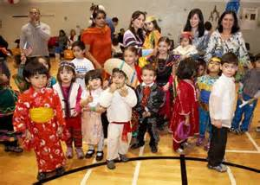
Diversity
Preschool environments expose students to diversity: varying social economic status, ethnicity, race, and gender.

Slide 13
Legislators and Policy Makers need to see that the money we invest now in Preschool will pay for itself.
Lower crime rates

Slide 14
Less dependence on Government Programs.
According to the Census Bureau, at the end of 2012,
109,631,000 of all 309,467,000 people living in the United States are receiving government assistance That is equivalent to 35.4 percent.

Slide 15
Higher Graduation Rates
This leads to higher
adult learning and
higher numbers of
skilled workers.
Companies want to
hire skilled workers.

Slide 16
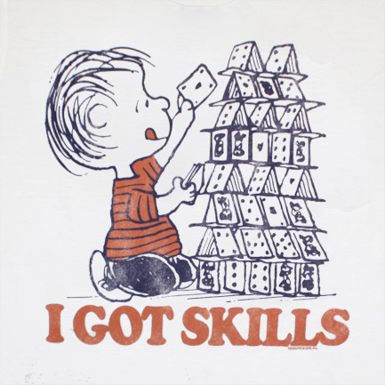
Ky has skills...
Increasing the skills of
a community,
increases the
economy of that
community by drawing
companies into the
local economy.

Slide 17
Investing in Preschool Pays for itself with a 3:1 dollar per capita return.

Slide 18
Many people argue that the barrier to offering universal high quality preschool is cost, but…….
It would cost $30 billion dollars to offer our country universal preschool. That equals out to $100 per capita.
If the return is 3:1 it would equal out to $83 billion dollars in extra earnings and 10% higher earnings for low-income and 5% higher earnings for middle class. Close The Gap!

Slide 19
What to do with ALL that extra $$$
The median annual wage for preschool teachers was $27,130 in May 2012.
Waste collection companies paid an average annual salary of $33,380, while local governments offered an average of $35,590 per year for a job as a trash collector.
Let’s take this extra earnings and pay our preschool teachers the money they deserve.

Slide 20
Monitoring Quality of Instruction and Skills
-While researching what is most important to parents and their children when choosing a preschool many of the parents agreed that the quality of the preschool mattered.
-Creating a high quality preschool should start with recruiting and employing high quality preschool teachers.

Slide 21
Monitoring Quality of Instruction and Skills
-Housing a preschool within an elementary school, will allow preschool teachers to be in close proximity to the kindergarten and elementary school teachers who will be receiving the preschool students later on.
-Teachers in the elementary school can set out the expectations that they are wanting to see from their future students and will also be able to keep the preschool teachers accountable.
-Both of these things will will definitely elevate the level of quality of preschools.

Slide 22
Monitoring Quality of Instruction and Skills
-To make sure that preschools are up to the challenge of being housed in elementary schools, the preschool teachers must be held to certain standards to be considered quality instructors.
-Existing preschool teachers can receive new and improved trainings that will provide them with better instructional tools.
-The Wisconsin Department of Public Instruction has been very dedicated to improving the standards of preschools and is starting with trainings being made available to their current preschool teachers and future preschool teachers. Many of the trainings are available online as well as locally in the state of Wisconsin.
-Preschool teachers were required to participate in these trainings online. This can be considered a step in the right direction to creating high quality preschools in the area that would be worthy of being housed in kindergarten and elementary schools.

Slide 23
Monitoring Quality of Instruction and Skills
-Make sure that preschool teachers’ skills are up to what they need to be. This can be started before they enter the professional world.
-Teacher education is something that has been undergoing a change in the last few years.
-Many preschool programs are beginning to require their head teachers to obtain a Bachelor’s degree in early childhood education.
-Teachers with a better education and more training will definitely help with their qualifications, but it is also up to their employers to make sure the teachers they are bringing into preschool classrooms have these qualifications by doing background checks and also providing or requiring training opportunities.

Slide 24
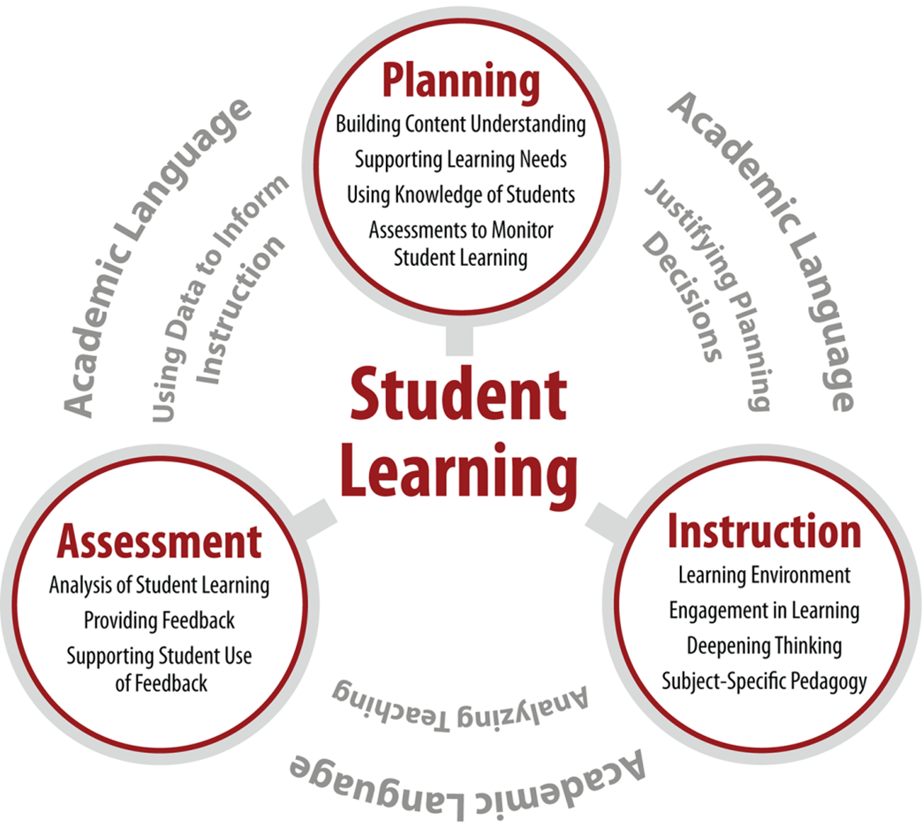
Monitoring Quality of Instruction and Skills
-Must keep preschool teachers accountable and the skills of preschool teachers need to be monitored.
-Having teachers being assessed on a regular basis will help make sure that the teachers’ instructional skills are effective for creating a quality preschool learning environment.
-There are assessments in place that can be used to
accomplish the goal of monitoring a preschool
teacher’s skills in the classroom.

Slide 25
Social, Emotional and Academic Needs
For young children, STABILITY is key in order to avoid:
behavioral problems
lack in cognitive development
problems in social and emotional development

Slide 26
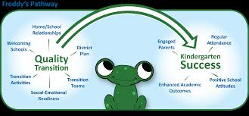
Transitional Demands
new academic challenges
new school environment
new teacher expectations
acceptance into a new peer group

Slide 27
Social, Emotional and Academic Needs
“social skills are what most affect school adjustment” (Ladd & Price)
“the reputations children establish with peers and teachers may follow them for long periods of time and potentially enhance or inhibit their learning and development” (Ladd & Price)
“up to 46% of teachers reported that half their class or more had specific problems in any of a number of areas in kindergarten transition” (Rimm-Kaufaman, Pianta & Cox)

Slide 28
Social, Emotional and Academic Needs
“…One-half of the 1,200 schools surveyed reported no communication between preschool and kindergarten teachers about curriculum coordination; only one-fifth had any formal transition activities” (Lewis)
Housing preschools within K-12 schools allows:
preschool and kindergarten teachers to communicate
stable environment for the children
familiar faces

Slide 29
Set Standards For Kindergarten Readiness

Slide 30
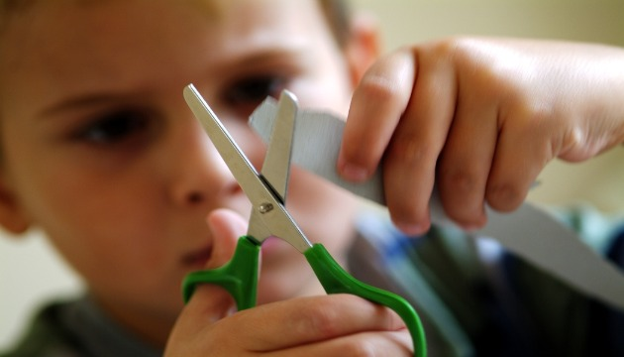
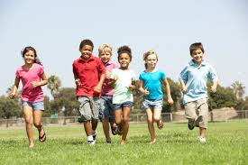
Physical Well Being & Motor Skills
Complete Simple Puzzle
Skips
Running, Jumping, climbing
Grasp crayon & scissors
Hold pencil properly
Pulls up pants and ZIPS IT UP!
Can put shoes on by themselves
String beads

Slide 31
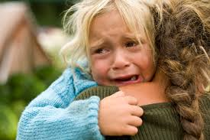
Social and Emotional Standards
Listens without interrupting 4. Separated from parents without being upset
2. Takes turns in games, reading, etc. 5. Asks for help when needed
3. Interacts well within groups 6. Ability to play by themselves

Slide 32
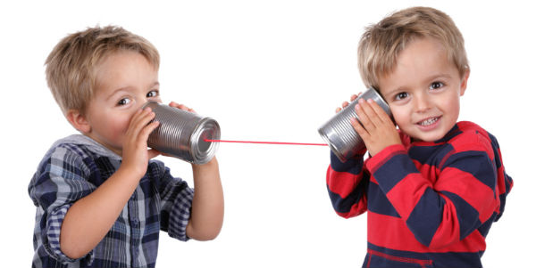
Language Development Standard
Speaks clearly and understandably
Speaks in complete sentences - using 5 words or more.
Can complete one-step and two-step directions
Appropriate volume levels when speaking with children and adults
Can verbally express emotions and feelings

Slide 33
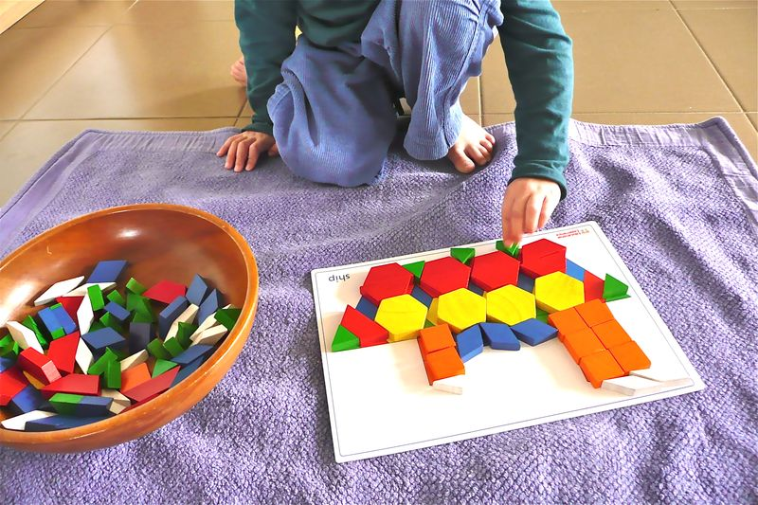
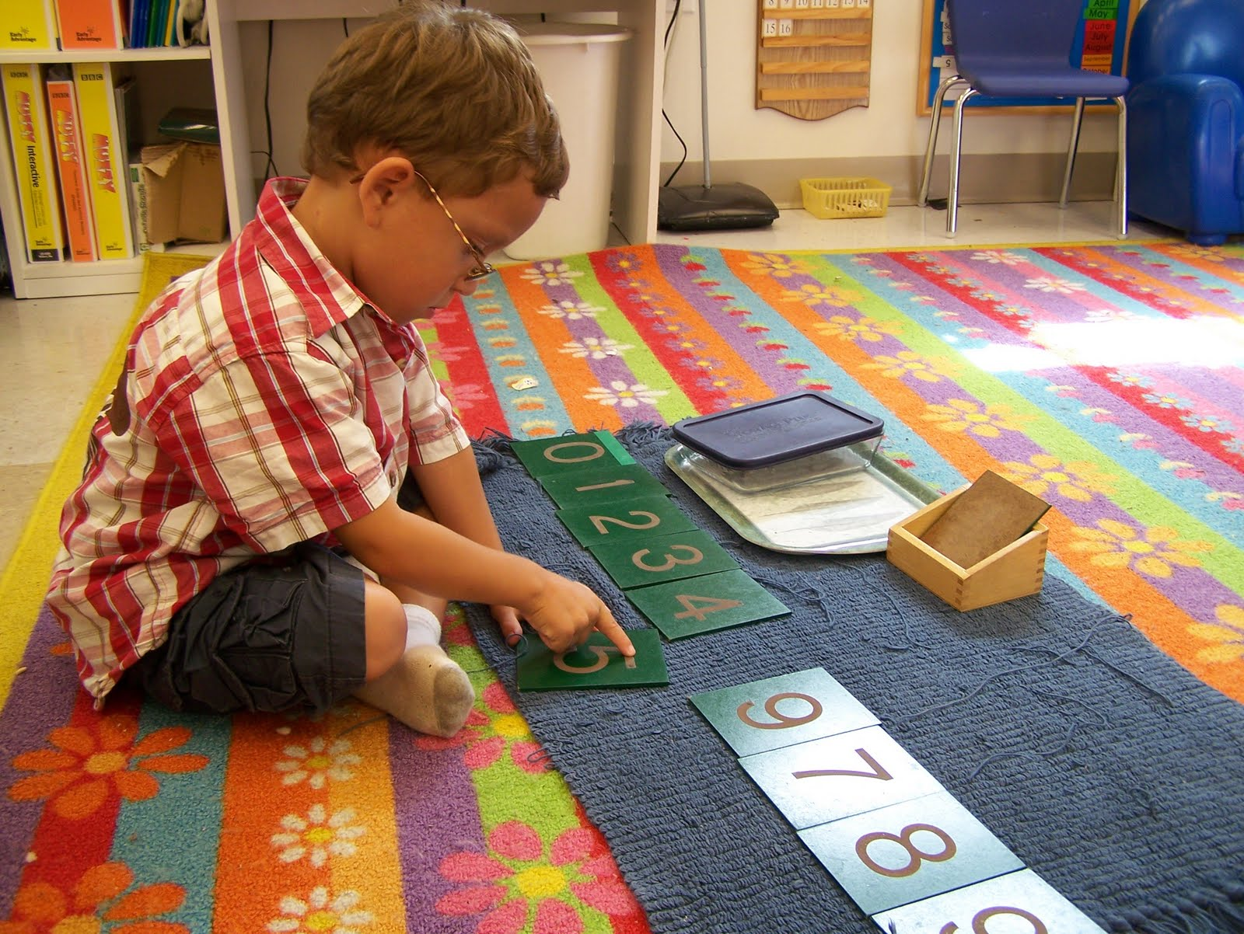
Academic Standards
Recite alphabet
Write name
Match pictures and words
Count to 20
Recognizes colors
Recite shapes
Upper and lowercase letters
Sort items
Arrange numbers

Slide 34
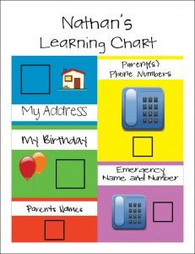
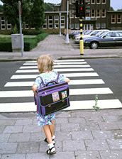
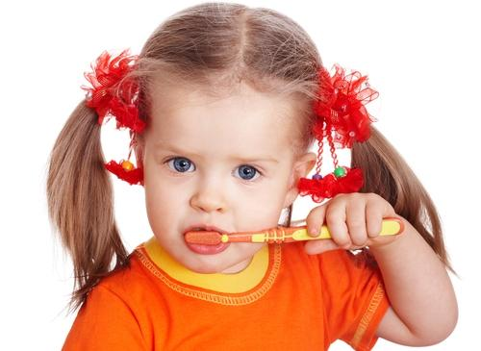
General Knowledge Standard
Knowledge of full name
Birthday and Age
Parent’s names, home address, emergency phone number
Understands general times (morning, afternoon, night)
Personal hygiene
General safety (crossing roads, fire, etc.)

Slide 35
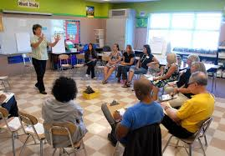
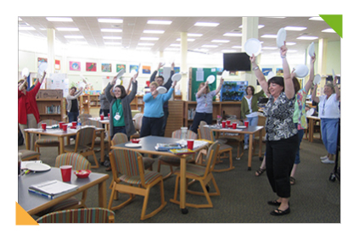
Curriculum Collaboration Between Kindergarten and Preschool Teachers
Early Learning Collaborative Act
Monthly meetings between kindergarten teachers and preschool teachers
During these meeting teachers set up workshops to instruct preschool teachers on the curriculum needing to be taught during that month
Effective teaching strategies are shown/given to preschool teachers to help aid
Preschool teachers get first hand experience on how to teach the material
Up to date on curriculum needing to be covered

Slide 36
Curriculum Continued…
Bi-weekly meetings between Kindergarten teachers and Preschool TEachers
Preschool teachers inform kindergarten teachers on their progress
Preschool teachers notify kindergarten teachers with areas of struggle, mastery, or concern
Children bio’s are given and address if any learning disabilities or effective teaching styles working for children
Kindergarten teachers meet with children during one of these meetings to begin interaction with new faces and trust

Slide 37
BAM… The End
Questions?

Slide 38
References
Barnett, S. (2014). Quality pre-K is an idea whose time has come. Debate Club, U.S. News & World Report. Retrieved from: http://www.usnews.com/debate-club/should-the-government-fund-universal-pre-k/quality-pre-k-is-an-idea-whose-time-has-come
Hamm, K. (2014). We can’t afford to not invest in pre-k. Debate Club, U.S. News & World Report. Retrieved from: http://www.usnews.com/debate-club/should-the-government-fund-universal-pre-k/quality-pre-k-is-an-idea-whose-time-has-come

Slide 39
References
Liu, G. (2006). Education, equality, and national citizenship. The Yale Law Journal, 116(2), 330-411.
Schweinhart, L. J. (2004). The High/Scope Perry Preschool study through age 40: Summary, conclusions, and frequently asked questions. High/Scope Educational Research Foundation.

